Slide 1
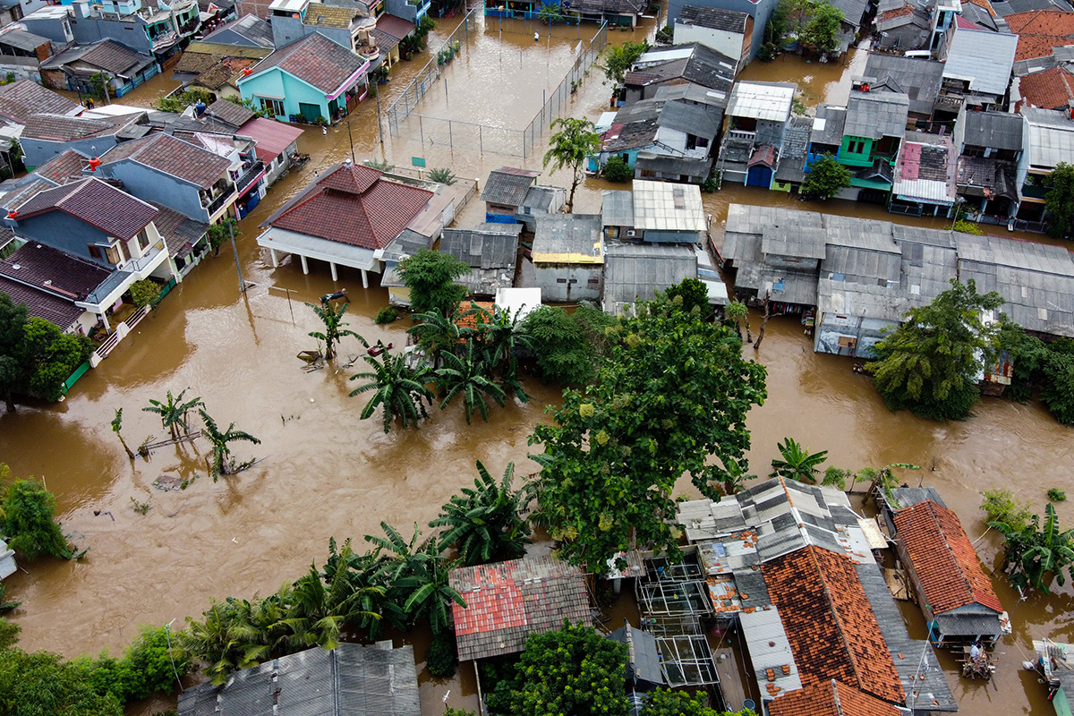
Does growth reduce poverty? The mediating role of carbon emissions and income inequality
Khanh Duong & Eoin Flaherty
Department of Sociology, Maynooth University, Ireland

Slide 2
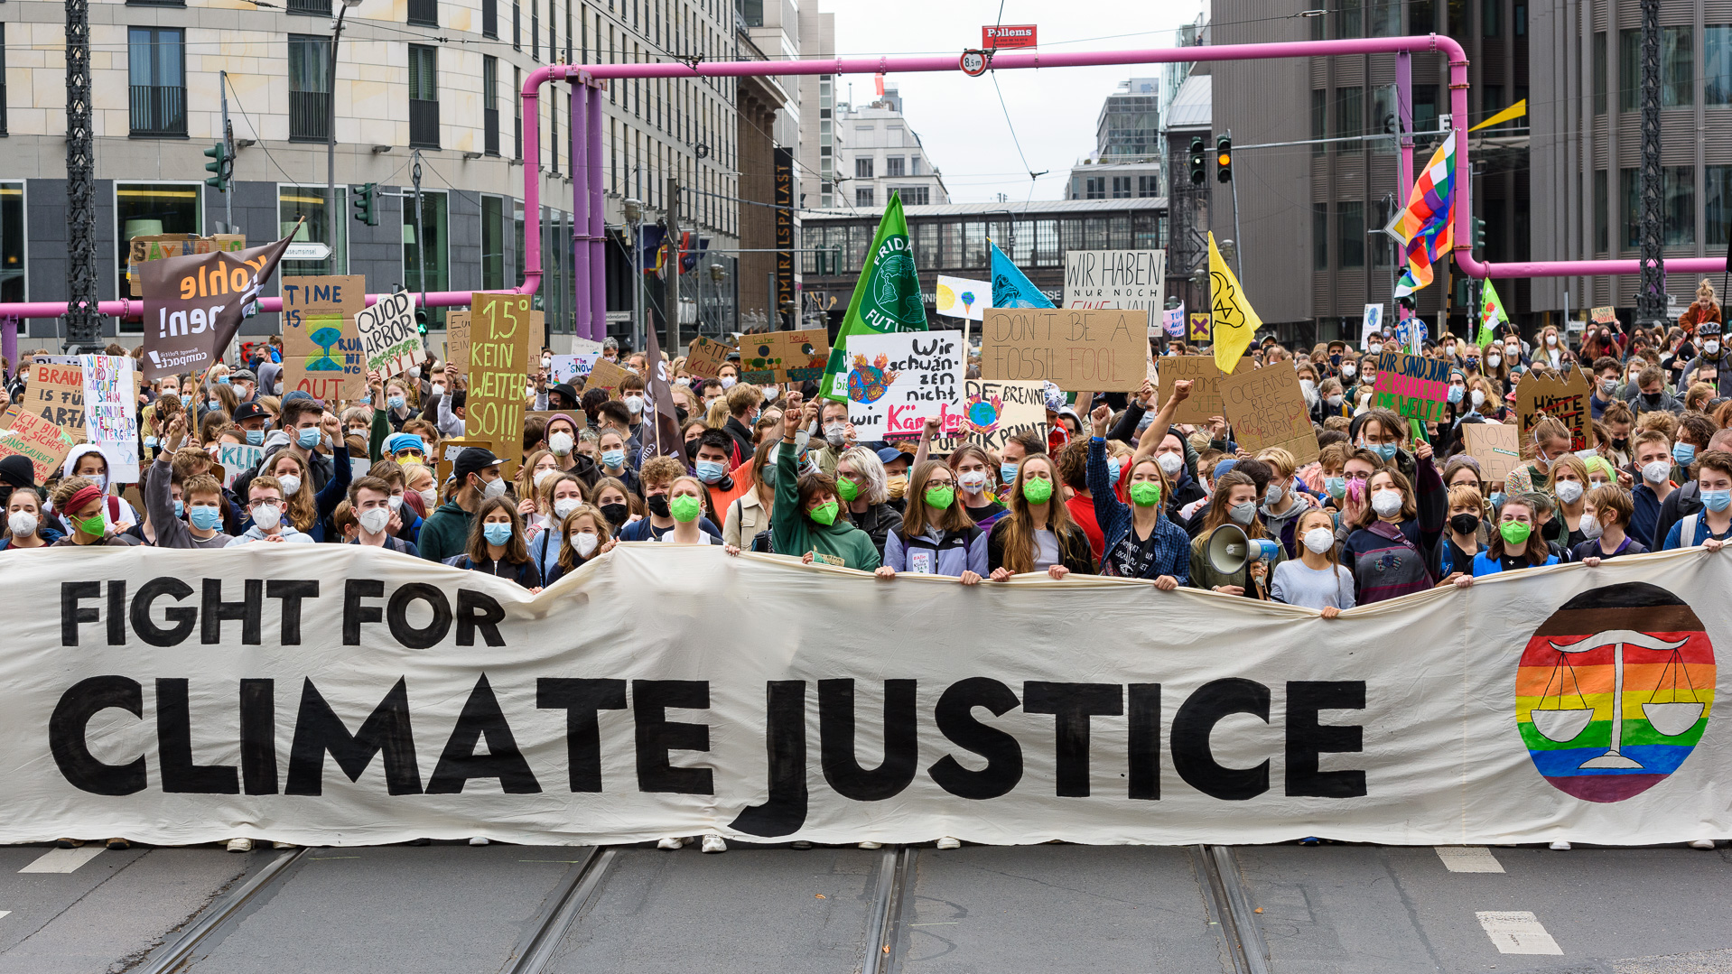
THE POOR
“the least contributor, but the most vulnerable to climate change”

Slide 3
The top 10% of earners accounted for
over half
of cumulative global emissions from 1990-2015 (Oxfam, 2020).

Slide 4
The World Bank estimates that climate change will push more than
32 million
people into extreme poverty by 2030 (Jafino et al., 2020).

Slide 5

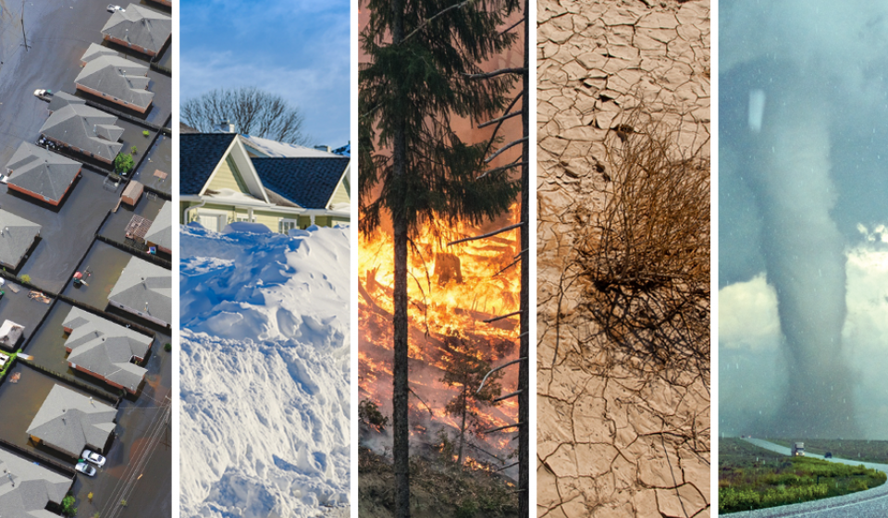
POVERTY AND CLIMATE CHANGE
It is an injustice that the poor – the least contributor to this phenomenon – is the most vulnerable of climate change consequences (Hallegatte et al., 2018; Oxfam, 2020).

Slide 6
POVERTY AND CLIMATE CHANGE
The impact of climate change on poverty through three mechanisms
Climate change
Severe weather events affect economic activities
Economy
To a whole country,
including the poor
Poverty

Slide 7
POVERTY AND CLIMATE CHANGE
The impact of climate change on poverty through three mechanisms
Climate change
Their ability to effectively manage climate risks
vulnerability
depend disproportionately on natural resources
Poverty

Slide 8
POVERTY AND CLIMATE CHANGE
The impact of climate change on poverty through three mechanisms
Climate change
At household level, selling assets or cutting expenditures
Self-reforcement
Loss of financial sources to escape
poverty traps
At regional level, measures to prevent (e.g. coastal dams)
Poverty

Slide 9
POVERTY AND CLIMATE CHANGE
The impact of climate change on poverty through three mechanisms
Climate change
Economy
vulnerability
Self-reforcement
Poverty

Slide 10
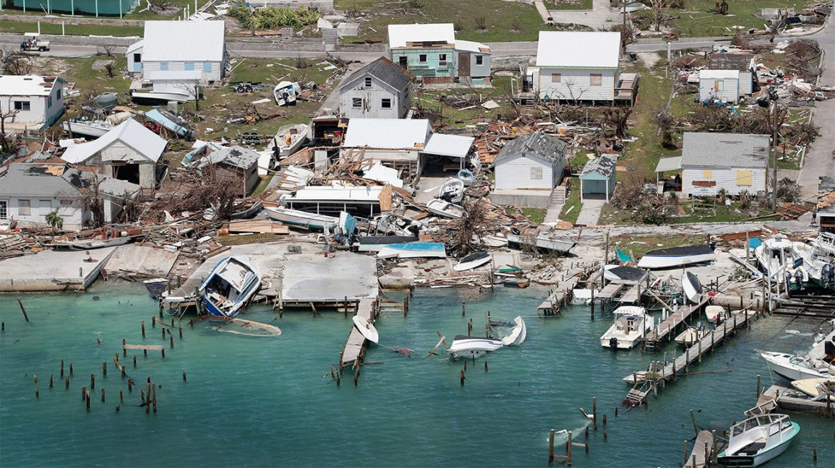
where does economic growth fit?
Growth has long been seen as a "panacea" for poverty alleviation, especially in developing countries (WorldBank, 2006).

Slide 11
where does economic growth fit?
How climate change may offset the positive effects of growth on poverty
Climate change
(Bergstrom, 2020)
GDP per capita
accounted for 90% of poverty reduction
Growth
3 mechanisms
Poverty
The alleviating effect

Slide 12
where does economic growth fit?
How climate change may offset the positive effects of growth on poverty
Carbon-intensive strategies
Climate change
Growth
3 mechanisms
Economic growth often depends on carbon-intensive technologies and sectors
(Fankhauser & Jotzo, 2018)
Poverty

Slide 13
where does economic growth fit?
How climate change may offset the positive effects of growth on poverty
Carbon-intensive strategies
Climate change
Growth
3 mechanisms
Poverty
The alleviating effect

Slide 14
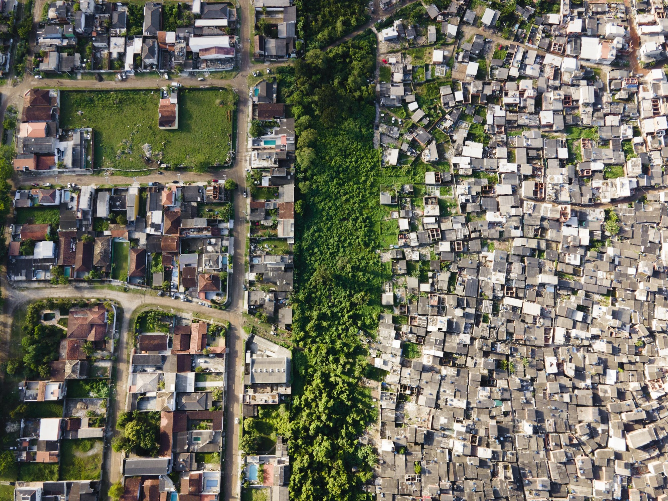
The cyclical traps of poverty, economic growth, and inequality
From a socioeconomic perspective, inequality as exacerbated by climate change can be considered on two levels: international (between-country) and social (within-country) (Islam & Winkel, 2017)

Slide 15
The cyclical traps of poverty, economic growth, and inequality
Climate change
The Kuznets Currve
The climate-inequality nexus
(Cappelli et al. 2021, Islam and Winkel 2017)
Growth
Inequality
Growth-Inequality-Poverty triangle
Poverty
Self-reinforcement

Slide 16
The cyclical traps of poverty, economic growth, and inequality
The New Triangle
Climate change
Interaction
Interaction
Growth
Interaction
Inequality
?
Poverty
Self-reinforcement
Growth-Inequality-Poverty Triangle

Slide 17
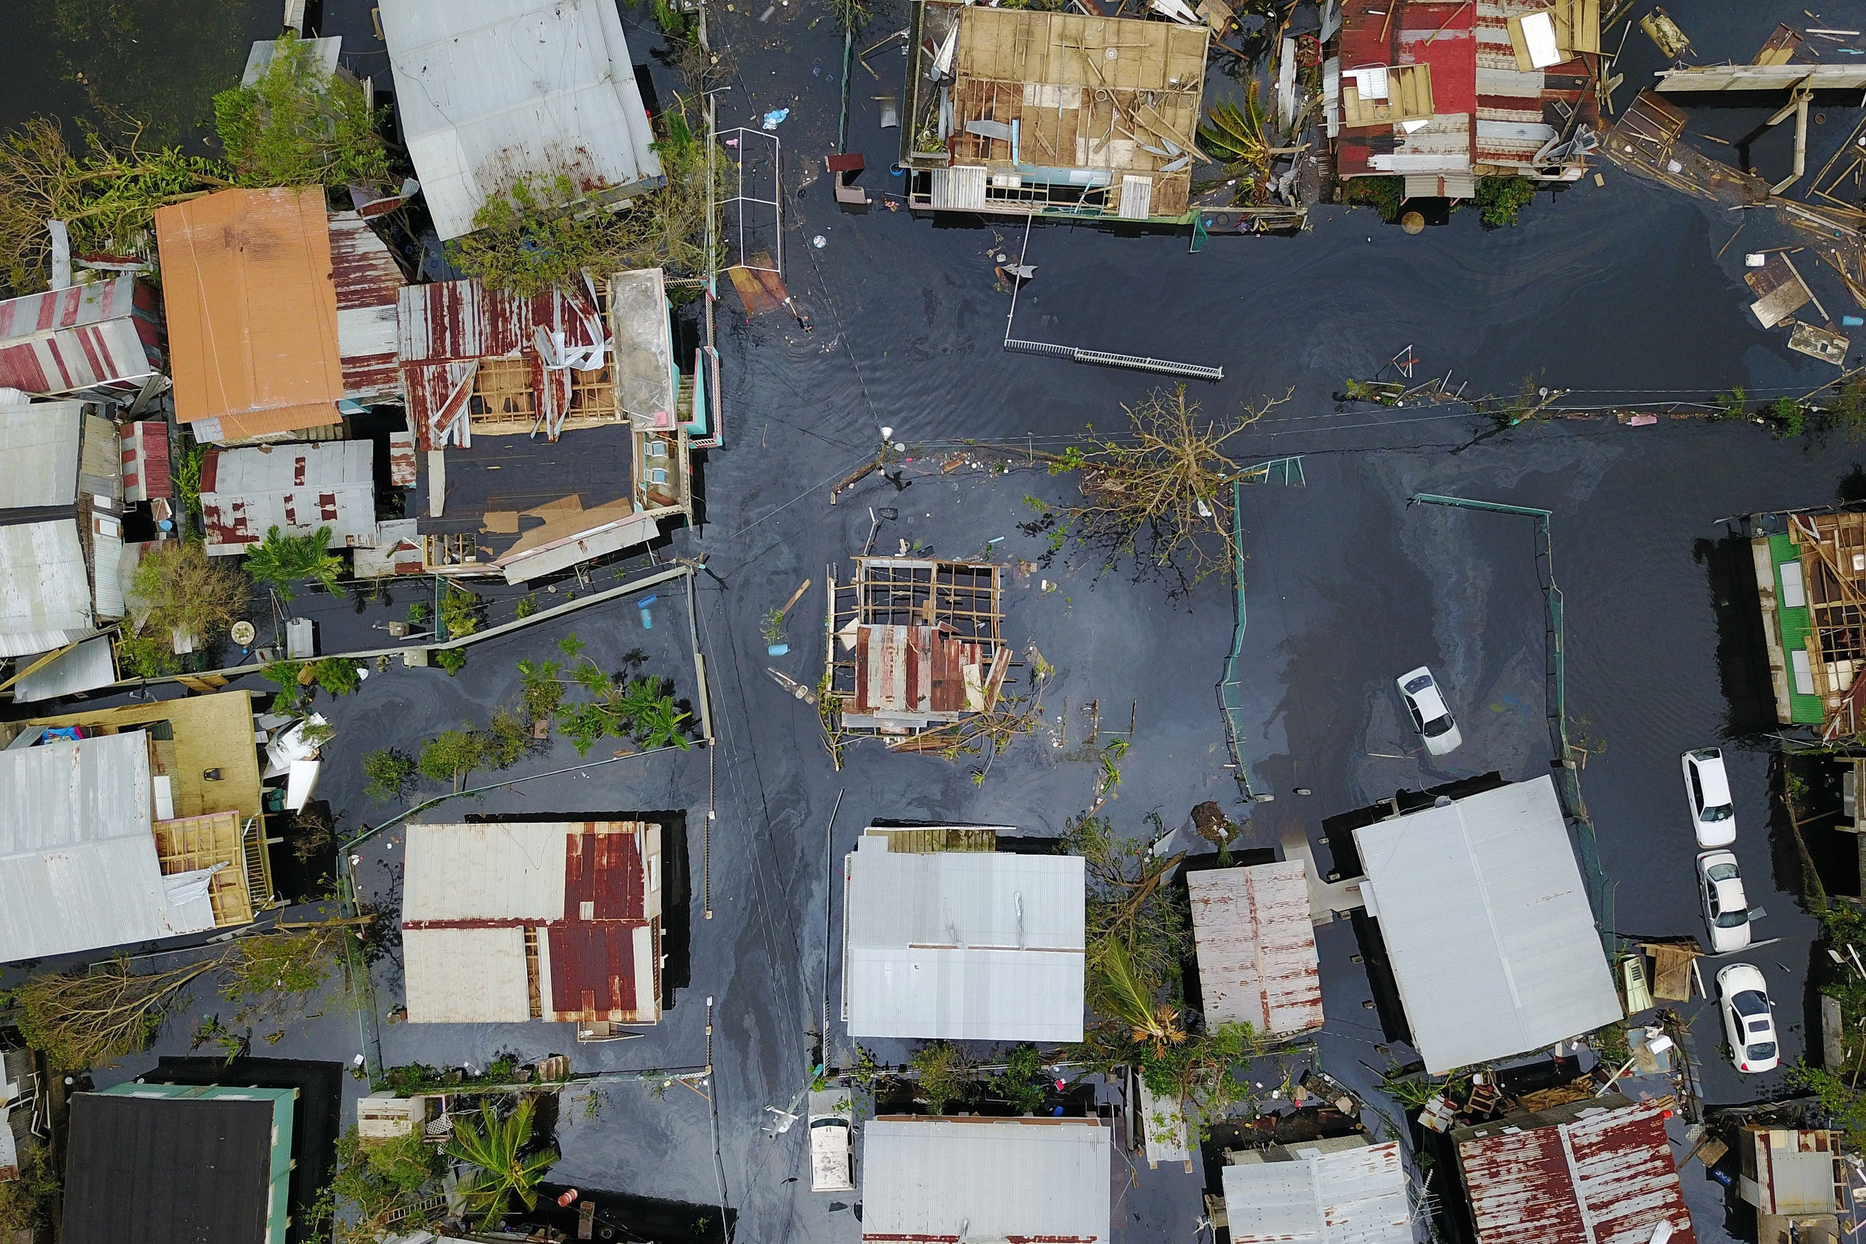
DOES GROWth REDUCE PROVERTY?
Khanh & Eoin (2022) uncover the new triangle between economic growth, income inequality and carbon emissions which, as we later demonstrate, partially hinders the beneficial effect of growth on poverty reduction.

Slide 18
DOES GROWth REDUCE PROVERTY?
The main obstacle
Mediating effects
Interaction
4
Control variables
Carbon emissions
Interaction
2
Direct effect
Economic growth
Poverty headcount
1
Income inequality
3
5
Interaction
Lag of Poverty
Within-country
Between-country

Slide 19
DOES GROWth REDUCE PROVERTY?
(population, renewable energy consumption, and urbanization)
Interaction
4
Control variables
Carbon emissions
Interaction
2
Economic growth
Poverty headcount
1
Income inequality
3
5
Interaction
Lag of Poverty
Poverty traps
Within-country
Between-country
High-income vs. Low-income
Poverty rate at variable bands

Slide 20
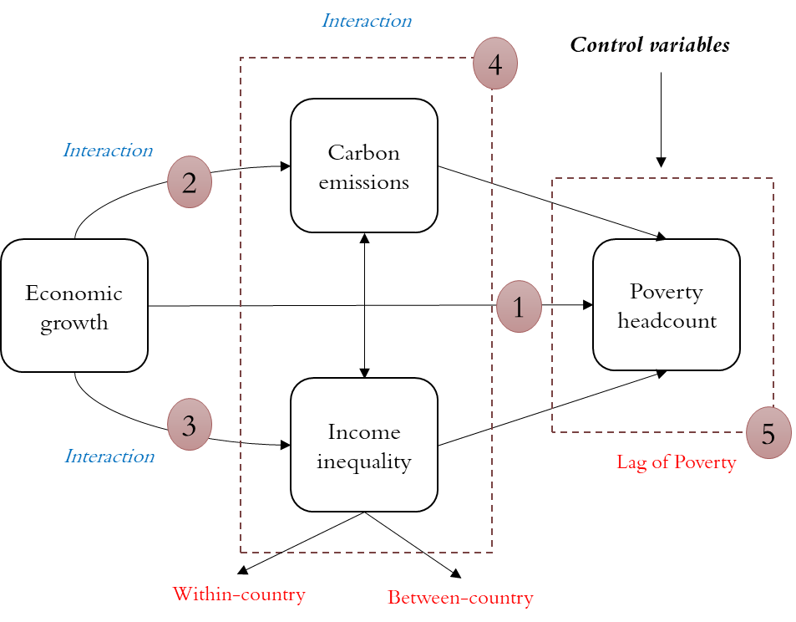
DOES GROWth REDUCE PROVERTY?
The main method: Generalized Method of Moments (GMM)
Endogeneity: the lagged poverty, the feedback effect of poverty to growth
Heteroscedasticity: using robust standard errors
Multicollinearity: dropping variables if violate this
Mediating effects: using interaction terms (product terms)
Serial correlation: the Arellano–Bond test at order two

Slide 21
Research findings
Our findings underscore the potentially damaging impact that would arise from global ‘one size fits all’ policies that do not account for the specific characteristics of low-income countries, and how variation in poverty is related to emissions, growth, and inequality.

Slide 22
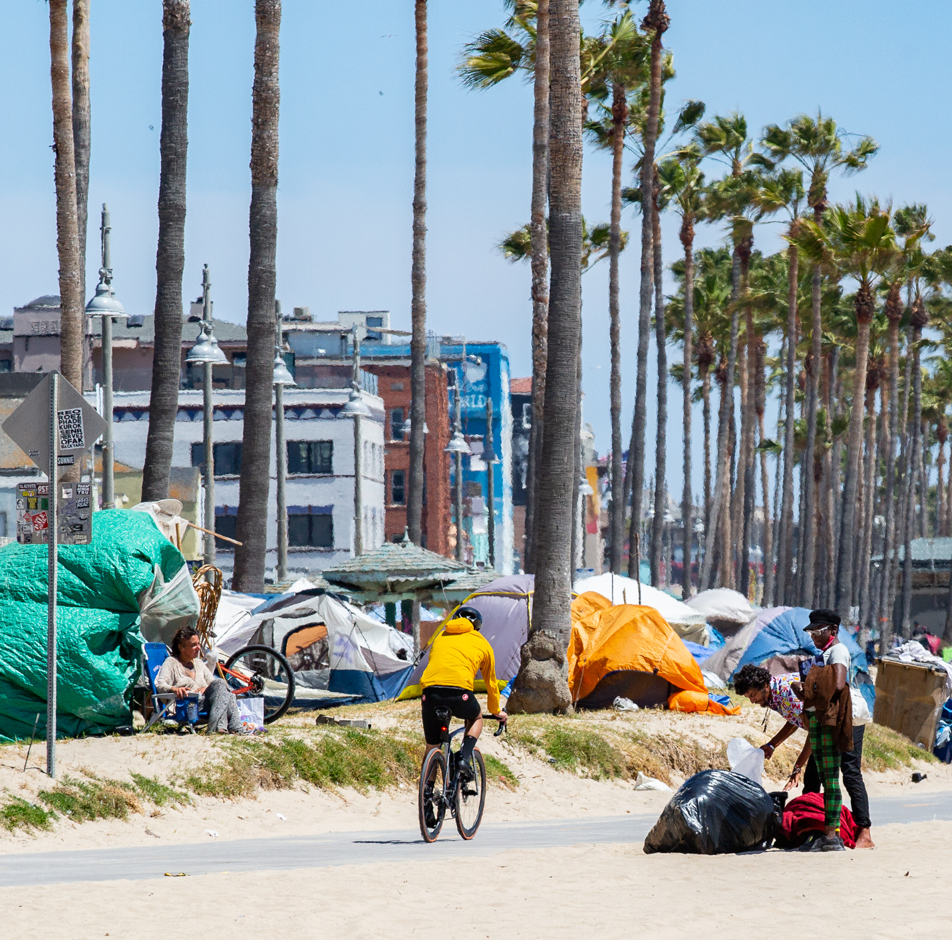
1
“Any emissions-intensive development policies aimed at addressing poverty alleviation in low-income countries must factor the mediating and negative role of inequality in the poverty-emissions pathway”(Khanh & Eoin, 2022).

Slide 23
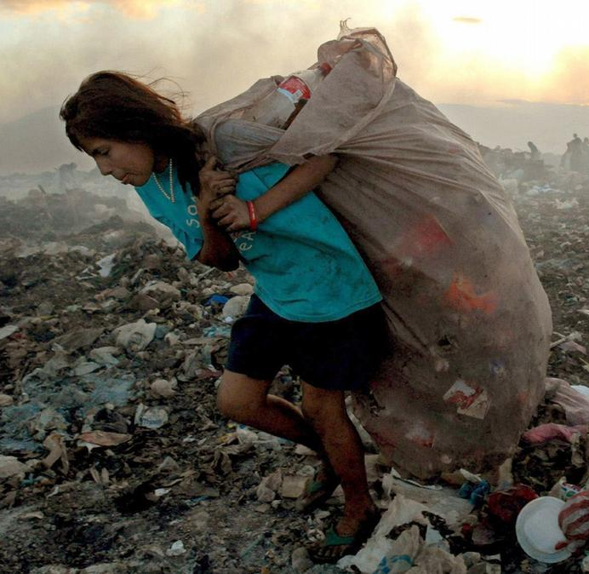
2
“The risk of inequality-driven poverty combined with a higher risk of poverty trap reinforcement, means that general mitigation policies aimed at ‘degrowth in general’ are unlikely to result in just outcomes for low-income countries” (Khanh & Eoin, 2022).

Slide 24
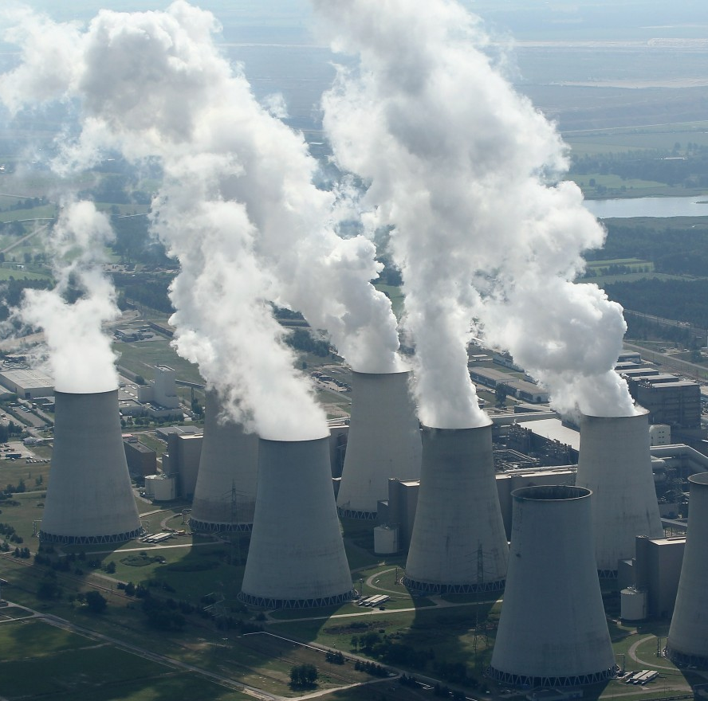
3
“In high-income countries, inequality is the main obstacle to poverty reduction, while in developing countries it is emissions in association with income inequality” (Khanh & Eoin, 2022).

